Slide 1


TECHNICAL ASSESSMENT DATA ANALYTICS
Question 4
SQL/MySQL Question

Slide 2
Table of Content
Table for Database Question
Question 4a
To generate desired output below:
Question 4b
Count of number of postal codes from Kings County?
Question 4c
Count of number of postal codes from each county?
Question 4d
Rearrange the dataset to generate the following table structure
Question 4e
Get all settlements in New Brunswick province using SQL JOIN function.

Slide 3
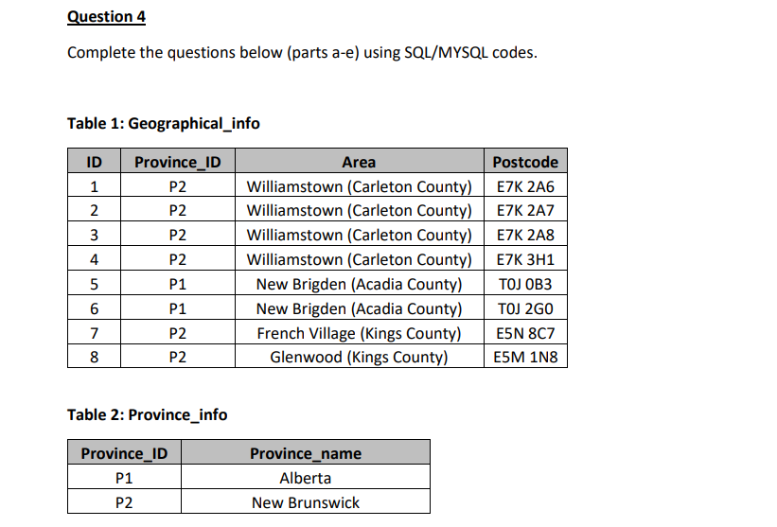

Table for Database Question

Slide 4
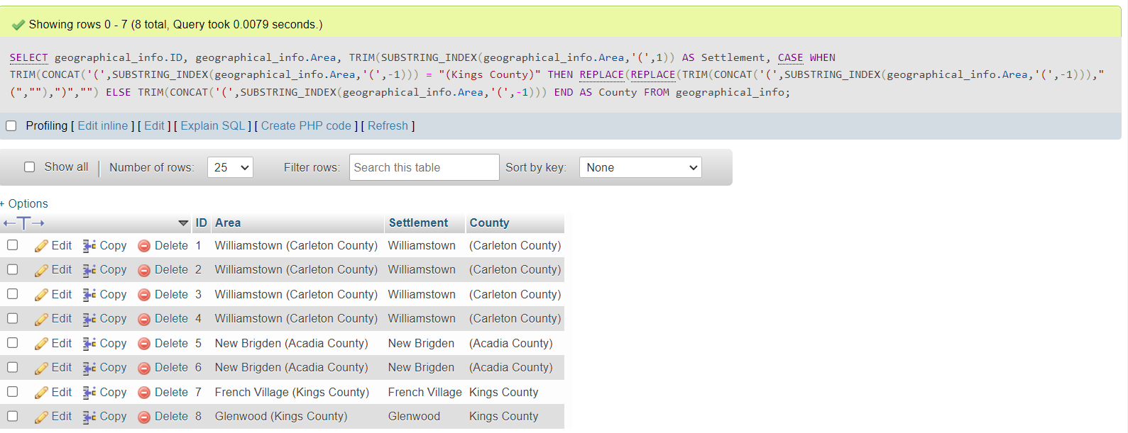
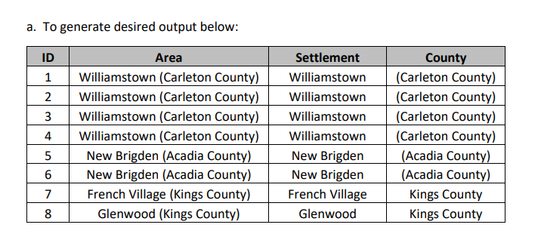
Separate Settlement and County

Slide 5
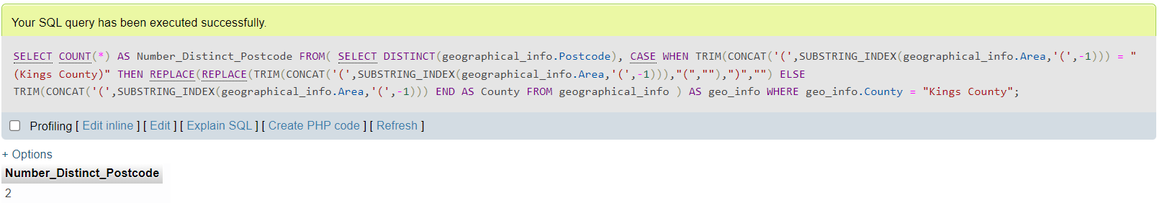
Count Number of Kings County’s Postal Code

Slide 6
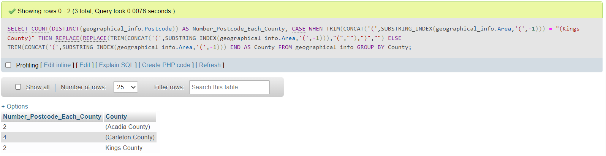
Count Number of Postal Code from Each County

Slide 7
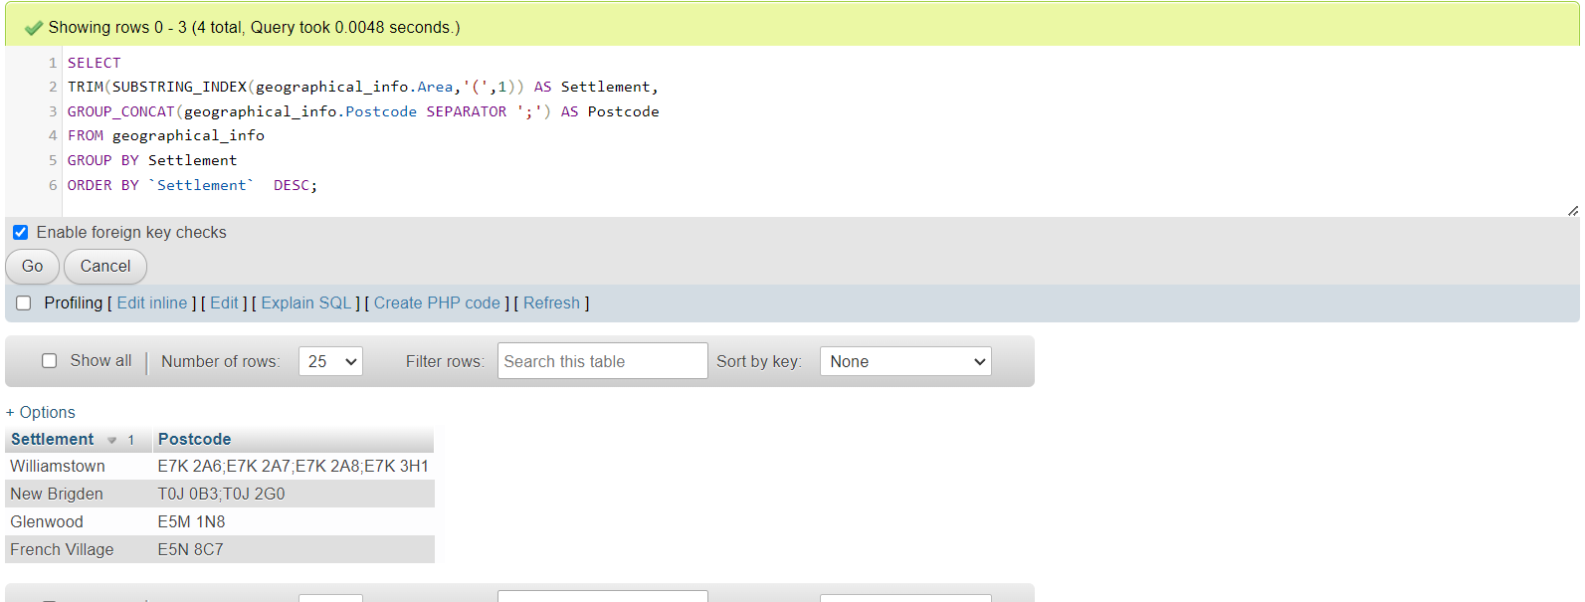
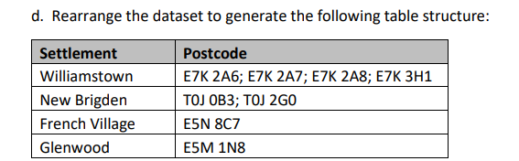
Rearrange and Group Concat Postal Code

Slide 8
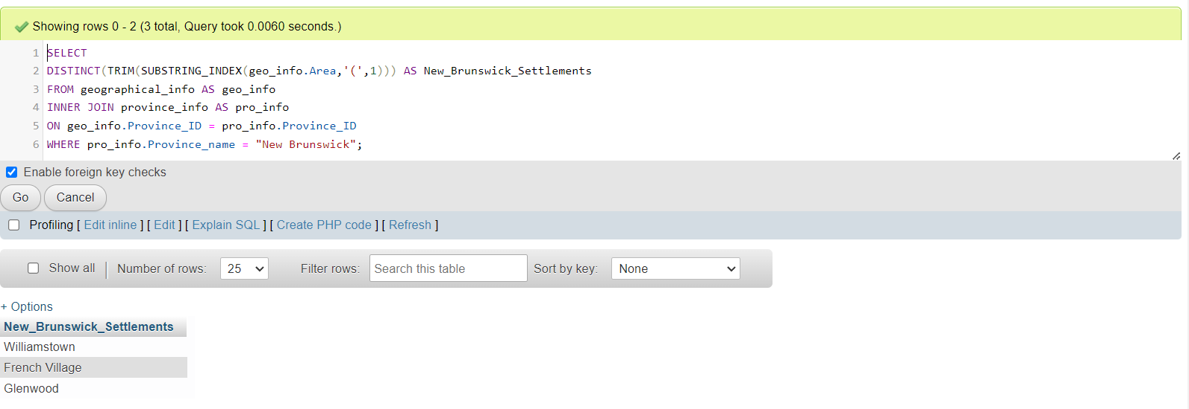
Settlement in New Brunswick using JOIN

Slide 9
THE END

